Slide 1

INSTITUTE OF AERONAUTICAL ENGINEERING
REVIEW-3
Department: Computer Science and Engineering
Project title: Optimizing Telecom Operations with Segmentation and Churn Prediction .
Mentor: Ms. K.Sangeeta , Assistant Professor, CSE Department.
Presented by –
D.Neha - 21951A05B8
Mohammed Ameesha - 21951A05A4 M.Dheeraj – 21951A0538

Slide 2
ABSTRACT
Telecom companies operate in highly competitive environments where customer churn poses a significant challenge. To address this issue, this explores the implementation of segmentation and churn prediction techniques to optimize telecom operations. By segmenting customers based on their behavior, preferences, and usage patterns, telecom companies can personalize their offerings and improve customer satisfaction. Additionally, employing churn prediction models enables proactive measures to retain at-risk customers, thereby reducing churn rates and enhancing revenue. This outlines the objectives and approaches utilized in optimizing telecom operations through segmentation and churn prediction.

Slide 3
INTRODUCTION
The telecommunications sector has displayed one of the central industries in
developed countries. Service companies like these suffer, particularly from
the loss of valuable customers due to competitors known as customer churn. The scientific progress and the growing number of operators increased the
level of opposition. Companies are pulling hard to survive in this aggressive
market, depending on complicated strategies.
The customer churn causes a considerable loss of telecom services and
becomes a severe problem. we aim to personalize customer experiences,
reduce churn rates, and allocate resources more effectively. The objective is
to maximize revenue growth by retaining high-value customers and improving
overall operational efficiency. Through data-driven insights and targeted
interventions, this project seeks to position our telecom company for success
in a dynamic and evolving marketplace.

Slide 4
OBJECTIVES
1. Enhance Customer Segmentation Accuracy:
Improve the precision and granularity of customer segmentation to better understand customer behavior and preferences.
2. Predict Customer Churn Proactively:
Anticipate and prevent customer churn by identifying at-risk customers and implementing proactive retention strategies.
3. Optimize Resource Allocation and Network Management:
Enhance network efficiency, capacity planning, and resource allocation to improve service quality and minimize operational costs.
4. Enhance Customer Experience and Service Quality:
Deliver personalized services, resolve issues promptly, and enhance overall customer experience to increase satisfaction and loyalty.

Slide 5
PROPOSED APPROACH
In this system, we use various algorithms like K-Nearest Neighbors (KNN), Decision Tree, and Support Vector Machine (SVM) classifiers. This example assumes you have a dataset with features and a target variable indicating whether a customer has churned or not.To find accurate values and which helps us to predict the churn of the customer. Here we implement the model by having a dataset that is trained and tested, which makes us have maximum correct values.In the Initial step, data preprocessing is performed in which we do filtering data and convert data into a similar form, and then we make feature selection. we observe the behavior of the customer and analyze them. In the final step, we do analysis based on the results obtained and predict the customer churn.

Slide 6
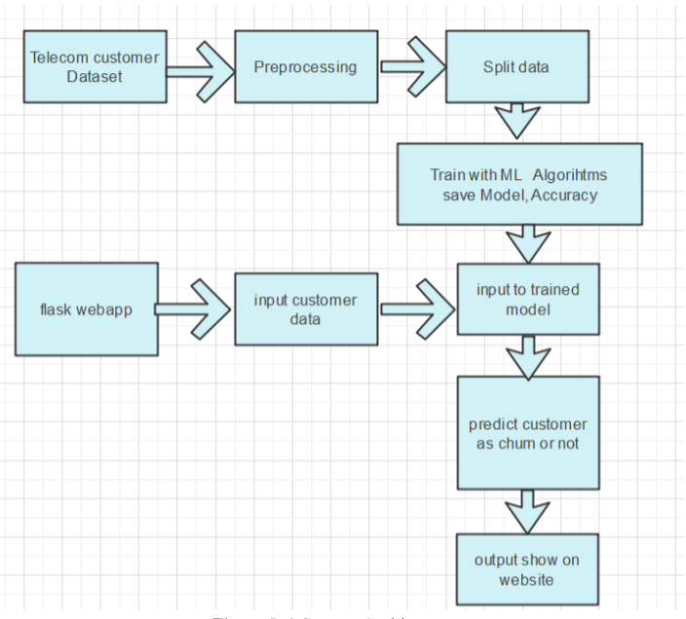
WORKFLOW

Slide 7
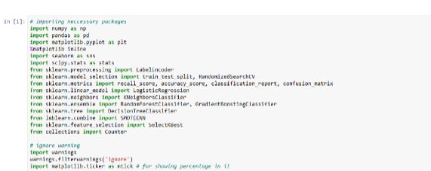
LIBRARIES
In this step multiple python libraries are imported using import statement. Thes libraries are used for data handling , pre-processing , Training models, data analysis and feature extraction . Sklearn is main for all machine learning algorithms which is imported in this step

Slide 8
ALGORITHMS
Random Forest model
Training Multiple Decision Trees
Bootstrap Sampling and Feature Selection: Create multiple subsets of the training data using bootstrap sampling (sampling with replacement) and train individual decision trees on these subsets, each time using a random subset of features.
Aggregating Predictions
Majority Voting or Averaging: For classification tasks, aggregate the predictions by majority voting among the trees; for regression tasks, aggregate by averaging the predictions of all the trees to get the final result.

Slide 9
ALGORITHMS
Logistic Regression (LR)
Model Training and Evaluation
Data Preparation: Use historical machine data to train Machine Learning (ML) classification algorithms, including Logistic Regression (LR), Random Forest (RF), and XGBoost.
Model Training: Train each algorithm (LR, RF, XGBoost) to forecast printing machine downtime based on real-time predictions of impending failures.
Performance Comparison
Evaluation Metrics: Analyze performance using metrics such as AUC (Area Under the Curve), ROC (Receiver Operating Characteristic) curve, Precision-Recall Curve (PRC), and confusion matrix components (False Positives (FP), True Positives (TP), False Negatives (FN), True Negatives (TN)) at different decision thresholds. Additionally, examine calibration curves.
Results: Although all algorithms perform similarly well in terms of the ROC curve, RF and XGBoost outperform LR at different decision thresholds. Logistic Regression is noted for estimating categorical outcomes based on independent variables, in contrast to linear regression, which estimates continuous outcomes.

Slide 10
ALGORITHMS
XGBoost
Step 1: Model Training
Initialization and Data Preparation
  Start with an initial prediction.
  Preprocess and split the data.
Sequential Tree Building
  Train the first tree to minimize the loss.
  Train each new tree to correct errors of the previous trees.
  Use gradient descent and regularization to optimize and prevent overfitting.
Step 2: Prediction and Evaluation
Aggregating Predictions
  Sum predictions from all trees.
  Convert to probabilities for classification and apply a decision threshold.

Slide 11
ALGORITHMS
Performance Evaluation
  Evaluate using metrics like accuracy, AUC-ROC, and others.
  Fine-tune hyperparameters with cross-validation.
  Deploy and monitor the model.
Gradient Boosted Machine Trees (GBM)
Step 1: Model Training
Initialization and Data Preparation
  Start with an initial prediction and preprocess the data.
  Split the data into training and testing sets.
Sequential Tree Construction
  Train the first tree to minimize the loss function.
  Train each subsequent tree to correct the errors of previous trees using gradient descent.

Slide 12
ALGORITHMS
Step 2: Prediction and Evaluation
Aggregating Predictions
  Sum the predictions from all trees.
  Convert to probabilities for classification and apply a decision threshold.
Performance Evaluation
  Evaluate using metrics like accuracy, AUC-ROC, and others.
  Fine-tune hyperparameters and deploy the model for real-time churn prediction.

Slide 13
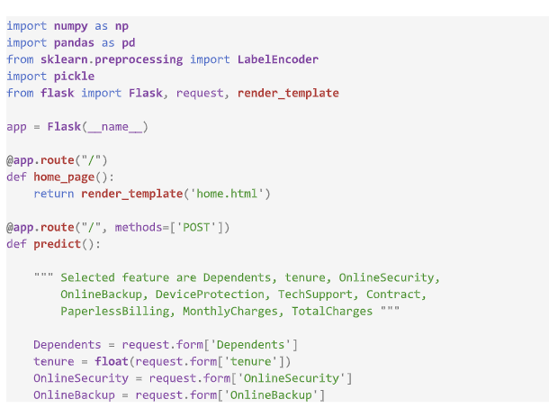
CODING

Slide 14
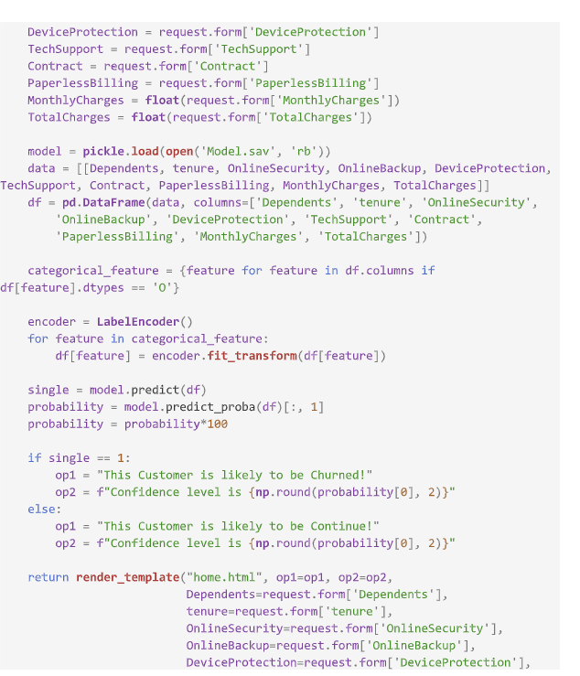
CODING

Slide 15
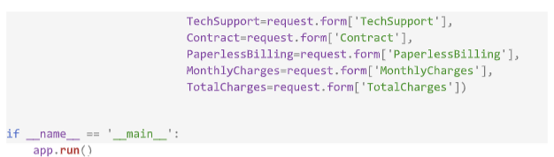
CODING

Slide 16
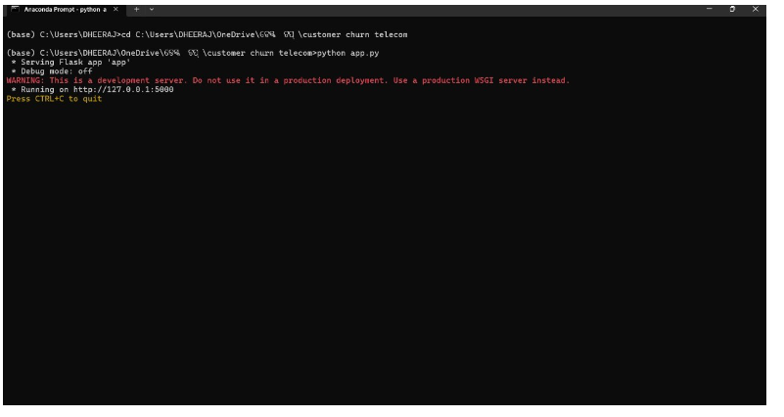
IMPLEMENTATION

Slide 17
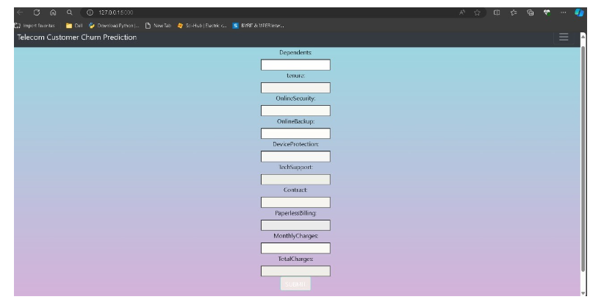
RESULT

Slide 18
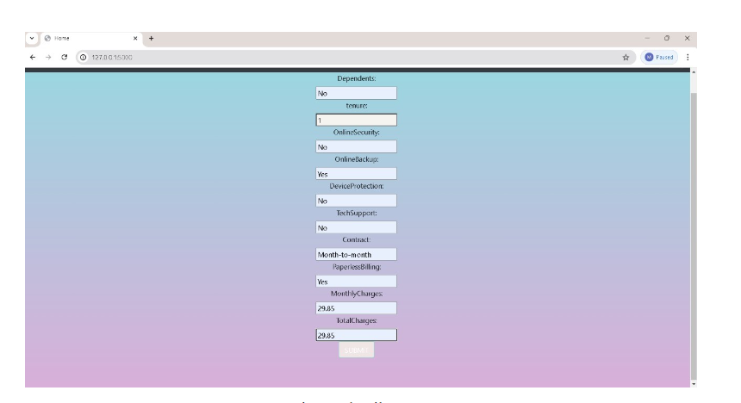
RESULT

Slide 19
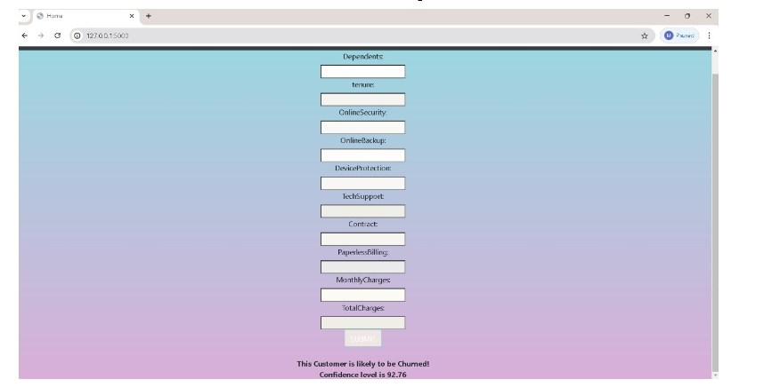

Slide 20
EXPECTED RESULT
1. Improved Churn Prediction Accuracy: Achieve a higher accuracy rate in predicting customer churn, leading to early identification of at-risk customers and proactive retention efforts.
2. Reduction in Churn Rate: Realize a measurable decrease in overall churn rate among targeted customer segments, resulting in improved customer retention and reduced revenue loss.
3. Enhanced Customer Segmentation: Utilize advanced segmentation to deliver personalized interventions and offers, resulting in increased customer satisfaction and loyalty.
4. Increase in Customer Lifetime Value (CLV): Improve CLV by retaining high-value customers identified through churn prediction models, leading to higher revenue generation over the customer

Slide 21
EXPECTED RESULT
5. Optimized Resource Allocation: Allocate resources more efficiently by focusing efforts on retaining existing customers rather than solely acquiring new ones, leading to improved operational efficiency and cost savings.
6. Positive Impact on Revenue and Profitability: Ultimately, achieve a positive impact on revenue and profitability through reduced churn, increased customer engagement, and optimized retention strategies.

Slide 22
CONCLUSION
The importance of churn prediction will help many companies, mainly in telecom industries, to have a profitable income and achieve good revenue. Customer churn prediction is the major issue in the Telecom Industry, and due to this, companies are trying to keep the existing ones from leaving rather than acquiring a new customer.

Slide 23


